Slide 1

INSTITUTE OF AERONAUTICAL ENGINEERING
REVIEW-3
Department: Computer Science and Engineering
Project title: Optimizing Telecom Operations with Segmentation and Churn Prediction .
Mentor: Ms. K.Sangeeta , Assistant Professor, CSE Department.
Presented by –
D.Neha - 21951A05B8
Mohammed Ameesha - 21951A05A4 M.Dheeraj – 21951A0538

Slide 2
INTRODUCTION
The telecommunications sector has displayed one of the central industries in
developed countries. Service companies like these suffer, particularly from
the loss of valuable customers due to competitors known as customer churn. The scientific progress and the growing number of operators increased the
level of opposition. Companies are pulling hard to survive in this aggressive
market, depending on complicated strategies.
The customer churn causes a considerable loss of telecom services and
becomes a severe problem. we aim to personalize customer experiences,
reduce churn rates, and allocate resources more effectively. The objective is
to maximize revenue growth by retaining high-value customers and improving
overall operational efficiency. Through data-driven insights and targeted
interventions, this project seeks to position our telecom company for success
in a dynamic and evolving marketplace.

Slide 3
ABSTRACT
Telecom companies operate in highly competitive environments where customer churn poses a significant challenge. To address this issue, this explores the implementation of segmentation and churn prediction techniques to optimize telecom operations. By segmenting customers based on their behavior, preferences, and usage patterns, telecom companies can personalize their offerings and improve customer satisfaction. Additionally, employing churn prediction models enables proactive measures to retain at-risk customers, thereby reducing churn rates and enhancing revenue. This outlines the objectives and approaches utilized in optimizing telecom operations through segmentation and churn prediction.

Slide 4
LIBRARIES
Churn prediction is a common use case in machine learning where the goal is to predict whether a customer will leave (churn) or stay with a company. To implement churn prediction, you can use a variety of Python libraries. Here are some key libraries typically used:
Data Manipulation and Cleaning
Pandas:
Used for data manipulation and analysis.
Helps in loading, cleaning, and preprocessing data.
NumPy:
Provides support for large multi-dimensional arrays and matrices.
Contains a collection of mathematical functions.

Slide 5
LIBRARIES
Data Visualization
Matplotlib:
Basic plotting library in Python.
Used for creating static, animated, and interactive visualizations
Seaborn:
Built on top of Matplotlib.
Provides a high-level interface for drawing attractive and informative statistical graphics.
Machine Learning
Scikit-learn:
Comprehensive library for machine learning.
Contains simple and efficient tools for data mining and data analysis.

Slide 6
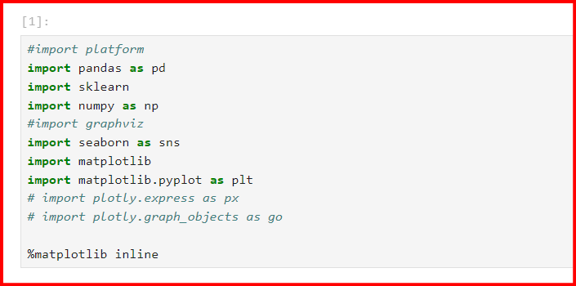
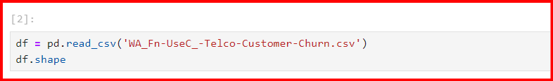
CODING

Slide 7
STEPS TO IMPLEMENT
Prerequisites for Building a Churn Prediction Model
Reviewing the Dataset
Exploratory Data Analysis for Customer Churn Prediction
Preprocessing Data for Customer Churn
Building the Customer Churn Prediction Model
Customer Churn Prediction Model Evaluation

Slide 8
IMPLEMENTATION
This implementation demonstrates how to:
Loading and Preparing Data:
Import data using pandas.
Handle missing values and encode categorical variables using pd.get_dummies.
Train-Test Split:
Split the dataset into training and testing sets using train_test_split.
Standardize Features:
Standardize features using StandardScaler to ensure that all features contribute equally to the distance calculations in KNN and the optimization process in SVM.

Slide 9
IMPLEMENTATION
Training Models:
Initialize KNN, Decision Tree, and SVM classifiers.
Train each model using the training data.
Evaluation:
Evaluate each model's performance on the test data using confusion_matrix, classification_report, and accuracy_score
This implementation covers the entire process from loading data to evaluating the performance of different classifiers for churn prediction. Adjust hyperparameters and preprocessing steps as needed for your specific dataset to improve performance.

Slide 10
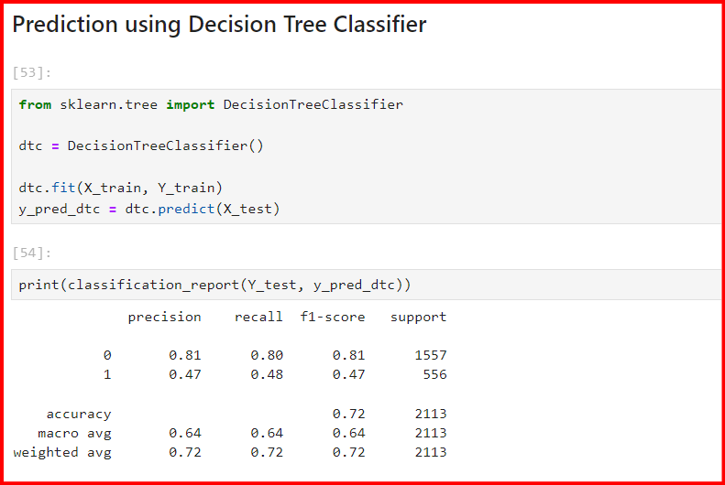
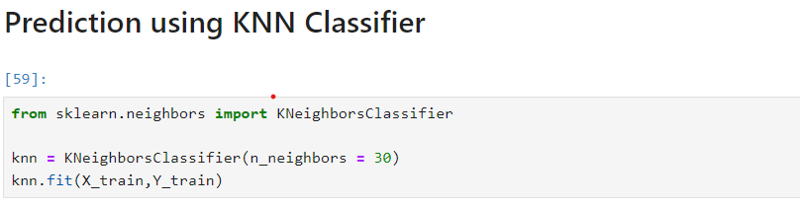
CODING

Slide 11
OBJECTIVES
1. Enhance Customer Segmentation Accuracy:
Improve the precision and granularity of customer segmentation to better understand customer behavior and preferences.
2. Predict Customer Churn Proactively:
Anticipate and prevent customer churn by identifying at-risk customers and implementing proactive retention strategies.
3. Optimize Resource Allocation and Network Management:
Enhance network efficiency, capacity planning, and resource allocation to improve service quality and minimize operational costs.
4. Enhance Customer Experience and Service Quality:
Deliver personalized services, resolve issues promptly, and enhance overall customer experience to increase satisfaction and loyalty.

Slide 12
PROPOSED APPROACH
In this system, we use various algorithms like K-Nearest Neighbors (KNN), Decision Tree, and Support Vector Machine (SVM) classifiers. This example assumes you have a dataset with features and a target variable indicating whether a customer has churned or not.To find accurate values and which helps us to predict the churn of the customer. Here we implement the model by having a dataset that is trained and tested, which makes us have maximum correct values.In the Initial step, data preprocessing is performed in which we do filtering data and convert data into a similar form, and then we make feature selection. we observe the behavior of the customer and analyze them. In the final step, we do analysis based on the results obtained and predict the customer churn.

Slide 13
EXPECTED RESULT
1. Improved Churn Prediction Accuracy: Achieve a higher accuracy rate in predicting customer churn, leading to early identification of at-risk customers and proactive retention efforts.
2. Reduction in Churn Rate: Realize a measurable decrease in overall churn rate among targeted customer segments, resulting in improved customer retention and reduced revenue loss.
3. Enhanced Customer Segmentation: Utilize advanced segmentation to deliver personalized interventions and offers, resulting in increased customer satisfaction and loyalty.
4. Increase in Customer Lifetime Value (CLV): Improve CLV by retaining high-value customers identified through churn prediction models, leading to higher revenue generation over the customer

Slide 14
EXPECTED RESULT
5. Optimized Resource Allocation: Allocate resources more efficiently by focusing efforts on retaining existing customers rather than solely acquiring new ones, leading to improved operational efficiency and cost savings.
6. Positive Impact on Revenue and Profitability: Ultimately, achieve a positive impact on revenue and profitability through reduced churn, increased customer engagement, and optimized retention strategies.

Slide 15
CONCLUSION
The importance of churn prediction will help many companies, mainly in telecom industries, to have a profitable income and achieve good revenue. Customer churn prediction is the major issue in the Telecom Industry, and due to this, companies are trying to keep the existing ones from leaving rather than acquiring a new customer.

Slide 16


